Slide 1
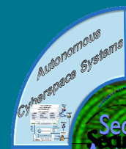

Use of Soar for Modeling Cyber Operations 36th Soar Workshop Ann Arbor, Michigan Denise Nicholson, Ph.D., Director of X Ryan O’Grady, Software Engineer denise.nicholson@soartech.com ryan.ogrady@soartech.com

Slide 2

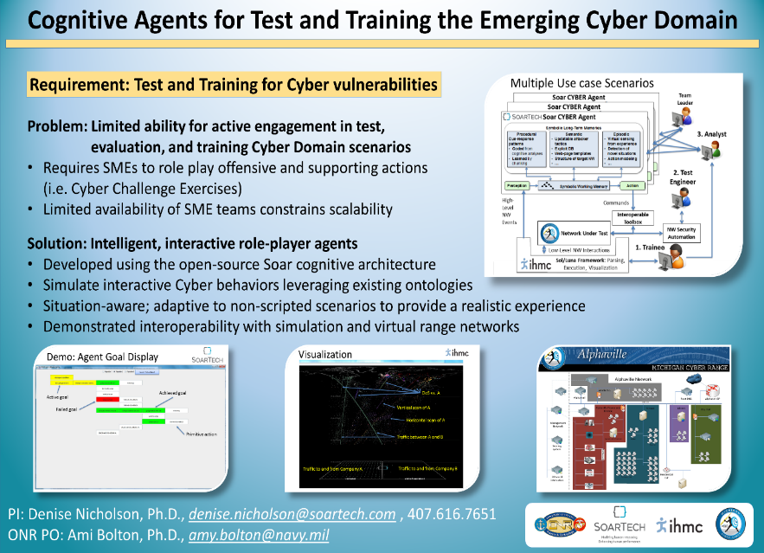
Phase II SBIR
ONR topic N132-132
POP FY15-17
SC2RAM
Simulated Cognitive Cyber Red-team Attacker Model
Notes:
What are you trying to do?
Who cares? What difference will it make?

Slide 3

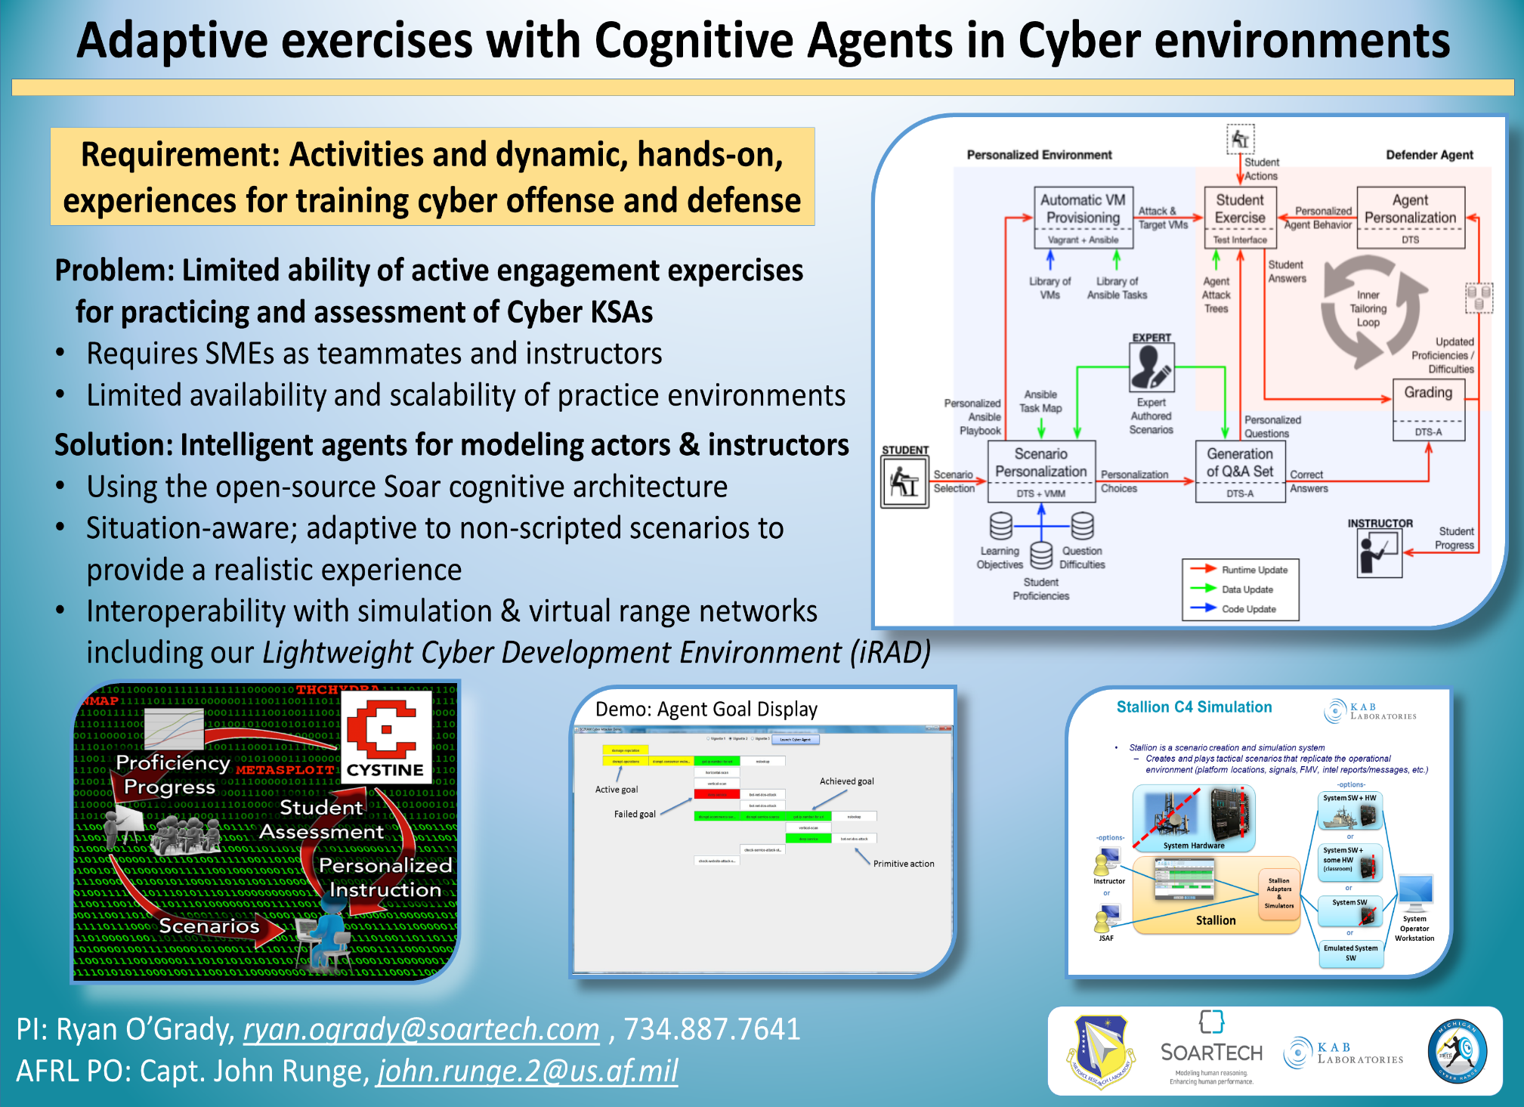
Phase II SBIR
AFRL topic AF141-031
POP FY15-17
CYSTINE
(CYber SecuriTy INstruction Environment)

Slide 4
How Soar links Cyberspace
Potential to represent Doctrinal Templates (Ontologies) of adversary / defense
Do not exist/are rudimentary for cyberspace operations
Useful for action->counter-action (i.e. maneuver), attribution, and deterrence
Must address cyberspace layers
Cyberspace Layer | Indicators | Relative Detection Difficulty | Adversary Cost to change
Cognitive/ Social | Intent/Goals TTPs Social Presence | Hard | Medium (harder after foothold is gained)
Logical | Malware variants IP addresses/TCP Ports Configurations/Logs | Low->Medium (depending on adversary sophistication) | Low
Physical | Infrastructure Computing devices Spectrum Location | Medium | High (lower after foothold is gained)
SoarTech expertise
Where most resources are spent

Slide 5
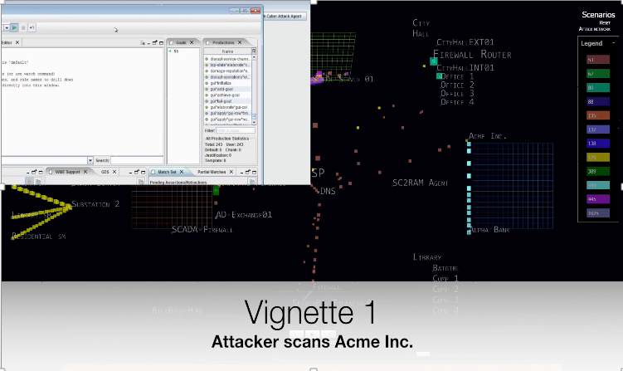
SC2RAM Agent Demonstration
Video URL

Slide 6
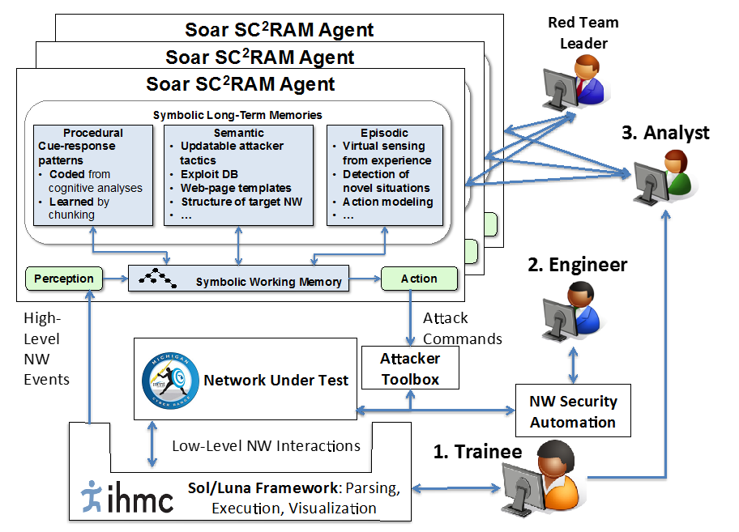
SC2RAM Architecture

Slide 7
Soar Agent in Brief
Built using “Forest of Goals” approach, variation of NGS
Goal Hierarchy read into WM from XML files
Attack-Defense Trees read into WM from XML files
General tasks and parameters to output link, translated into network commands via HackerToolkit
Results of network commands translated via HackerToolkit and written to input link

Slide 8
Overview of Behavior
The agent’s top-level goal is to access and explore the file system of a particular network space
Because the target information is on a file system, the agent decides it needs access to the file system
The agent decides to try to achieve access by mining user credentials for the system
This leads to recursive subgoals to locate an information source that may contain credentials, search the exfiltrated information for credentials, and then (if found) use those credentials to access the system

Slide 9
Under The Hood – Agent Knowledge
The agent’s knowledge is structured as a set of modular goals that can interleave in multiple ways to support different situations. Example:
A “Possess information” goal is required to possess files on the target file-system.
There are many possibly ways to “Possess information”, based on the information location, type, medium, etc.
One way to gain access to files on a file system is to exfiltrate (again with various potential methods) some user credentials for the system.
This in turn generates a different “Possess information” goal, which can again be achieved in multiple possible ways.
The threading and interleaving of goals for a particular attack generates an “Attack tree” structure, but the underlying goals are more of a graph
The specific demo generates a single “Attack tree” trajectory, but the underlying knowledge representation has numerous placeholders ready to be populated with additional choices, representing a variety of Tactics, Techniques, and Procedures

Slide 10
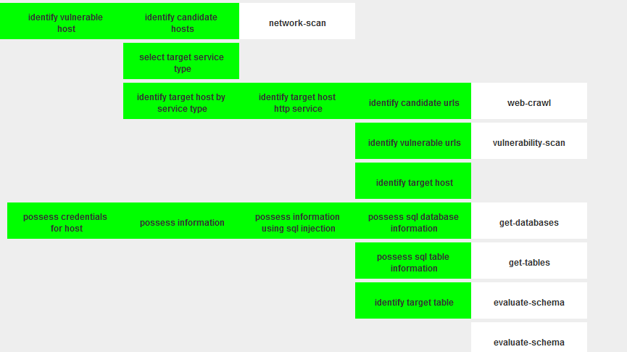
Generated/Composed Attack Tree

Slide 11
Under The Hood – Interaction Middleware
Design objectives:
Use existing, standard cyber operations tools
Support realistic attack Tactics, Techniques, and Procedures
Support future adaptation and extension as toolkits increase in sophistication
Generalize agent-tool interactions
Allow reuse of agent reasoning to heterogeneous tools that perform similar functions
Decouple decision making from details of attack execution
Support easy integration of new tools
Keep toolkit up to date with state of the art at low cost
Keep toolkit additions decoupled from agent knowledge enhancements

Slide 12
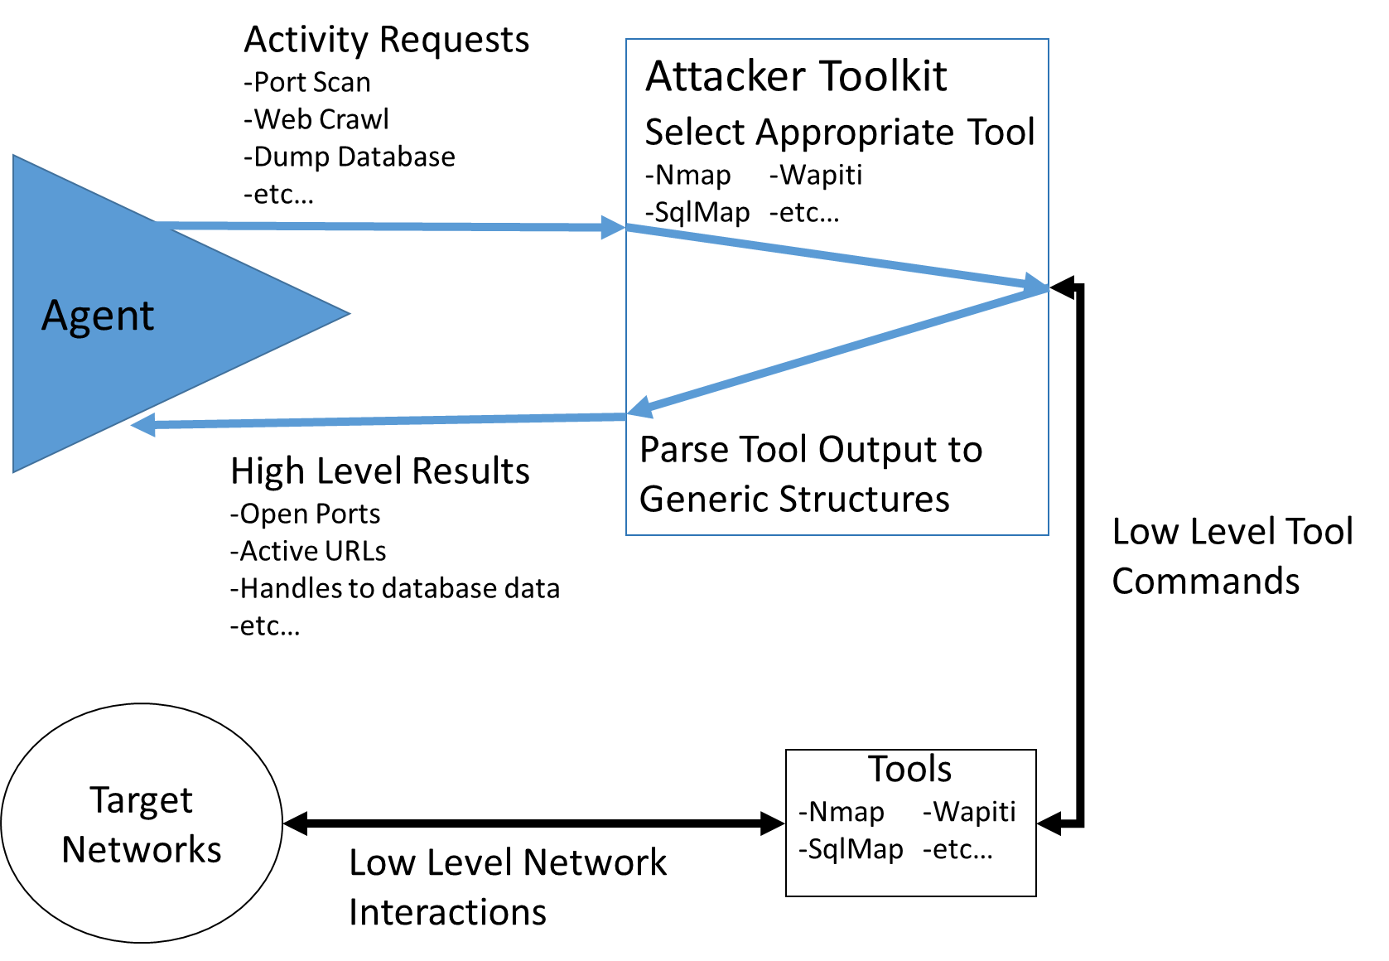
HackerToolkit Middleware Architecture

Slide 13
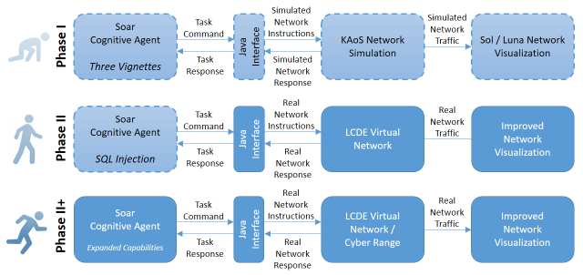
Crawl, Walk, Run
Initial demonstration at the end of the Phase 1 Option in 3 vignettes with IHMC’s KAoS network simulation.
Demonstrated interoperability with the Michigan Cyber Range (MCR) Alphaville virtualized network.
Current Phase II efforts expanded cognitive agent capabilities in situations relevant to transition customer’s scenarios – i.e. capability or tool for a Cyber Exercise

Slide 14
What Comes Next
Moving Goal Hierarchy and Attack-Defense Trees to Semantic Memory
Plan Recognition to predict adversary actions
Explore how Episodic Memory could be used

Slide 15
Nuggets & Coal
Nuggets | Coal
A great “wicked problem” to explore learning mechanisms | Resource intensive knowledge acquisition and representation
Explanation of agent’s decisions is valuable | Difficult to demonstrate autonomous vs automated for such complex domain

